Slide 1

Sales Insights - Data Analysis Project using Tableau
By – Upesh Jeengar
linkedin.com/in/upesh-jeengar

Slide 2
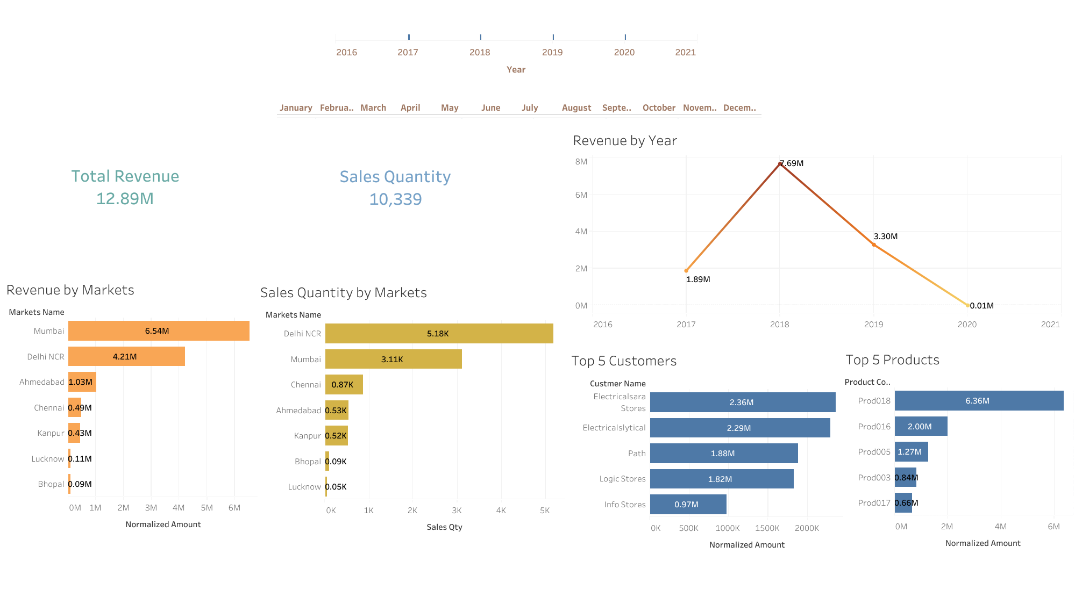

Slide 3
